Slide 1
19IT212 - Formal Languages & Automata Theory and Compiler Design

Slide 2
Introduction to Automata Theory UNIT-1 II B.TECH – II SEMESTER SUB.CODE: 19IT212

Slide 3
Automata Theory
An automaton has a mechanism to read input, which is string over a given alphabet. This input is written on an input tape / file, which can be read by automaton but cannot change it.
Input ﬁle is divided into cells each of which can hold one symbol. Automaton has a control unit which is said to be in one of finite number of internal states. The automation can change states in a deﬁned way.

Slide 4
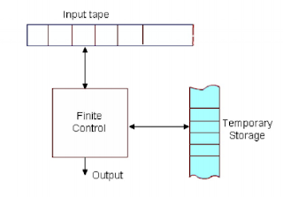
Finite Automata
Fig: Diagrammatic representation of a
generic automation

Slide 5
Finite automata
A finite automata consists of a finite memory called input tape, a finite non-empty set of states, an alphabet, a read-only head, a transition function which defines the change of configuration, an initial state and a finite-non empty set of final states.
Input tape is divided into cells and each cell contains one symbol from of which can hold one symbol.

Slide 6
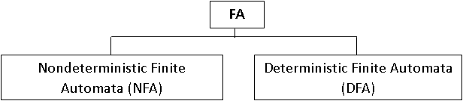
Types of Finite Automata:

Slide 7
Deterministic Finite Automata(DFA)
Formal Definition:
A deterministic ﬁnite automaton is defined by a quintuple (5-tuple): A = (Q, ∑, 𝛿, q₀, F). Where,
Q = Finite set of states, ∑= Finite set of input symbols, 𝛿= A transition function that maps Q X ∑ → Q qo: A start state; qo∈Q F= Set of ﬁnal states; F ⊆ Q.

Slide 8
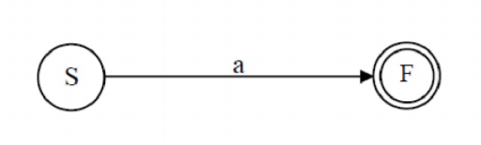
A transition function 𝛿 that takes as arguments a state, an input symbol and returns a state.
In our diagram, is represented by arcs between states and the labels on the arcs.
If s is a state and a is an input symbol then 𝛿(p,a) is that state q such that there are arcs labeled ‘a’ from p to q.

Slide 9

General Notations of DFA:
There are two preferred notations for describing automata.
Transition Diagrams
2. Transition Tables
1. Transition Diagrams
A transition diagram for a DFA A = (Q, ∑, 𝛿, qo, F). is a graph
defined as follows: For each state is node represented by circle.
(q is State)

Slide 10


General Notations of DFA:
A start stat is represented by a circle with preceding arrow labeled at start.
Final state is marked by a double circle (q is Final State)
(q is Final State)

Slide 11
General Notations of DFA:
For each state q in Q and each input a in ∑ , if 𝛿(q, a) = p then
there is an arc from node q to p labeled a in the transition
diagram.
If more than one input symbol cause the transition from state q
top then arc from q to p is labeled by a list of those symbols.
𝛿(q,a)=p

Slide 12
Example #1
Build a DFA for the following language:
L = {w | w is a binary string that contains 01 as a substring}

Slide 13
DFA for strings containing 01
What makes this DFA deterministic?
Q = {q₀,q₁,q₂}
∑ = {0,1}
start state = q₀
F = {q₂}
Transition Table
1
0
0,1
start
0
1
q₀
q₁
q₂
Accepting
state
Input symbols
0
1
q₀
q₁
q₀
states
q₁
q₁
q₂
*q₂
q₂
q₂

Slide 14
Example #2
CONSTRUCTION OF DFA: IN TYPE-01 PROBLEMS
Step-01:
Determine the minimum number of states required in the DFA.
Draw those states.

Slide 15
Example #2
RULE
Calculate the length of substring.
All strings ending with ‘n’ length substring will always require minimum (n+1) states in the DFA.
Step-02:
Decide the strings for which DFA will be constructed.
RULE
While constructing a DFA,
Always prefer to use the existing path.
Create a new path only when there exists no path to go with.

Slide 16
Example #2
Step-03:
Construct a DFA for the strings decided in Step-02.
Step-04:
Send all the left possible combinations to the starting
state.
Do not send the left possible combinations over the dead state.

Slide 17
Example #2
Draw a DFA for the language accepting strings ending with ‘01’ over input alphabets ∑ = {0, 1}
Step-01:
All strings of the language ends with substring “01”.
So, length of substring = 2.
Thus, Minimum number of states required in the
DFA = 2 + 1 = 3. It suggests that minimized DFA will have 3 states.

Slide 18
Example #2
Step-02:
We will construct DFA for the following strings-
01
001
0101

Slide 19
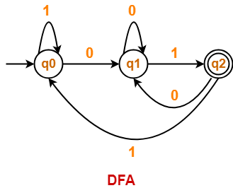
Example #2
Step-03:
The required DFA is-

Slide 20
DFA M = (Q, ∑, 𝛿, q₀, F).
Q = {q0,q1,q2}
∑ = {0,1}
start state = q₀
F = {q2}
Transition Table
 | 0 | 1
q₀ | q₁ | q₀
q₁ | q₁ | q₂
q₂ | q1 | q₀

Slide 21
THANK YOU

